Slide 1
Welcome

Slide 2
FOODIE APP
Team 5
Team Members
ALBY ANTONY :168016
ASWATHI N: 168029
T.JENIS JOSE: 168017
Guided by
Mr.SACHIN DHADWAL
(Stackroute)

Slide 3
Objective
Build an online food ordering application
Where customer can find different cuisines based on cuisines name , restaurants and location
Customer can place order and also cancel order in the same service
Using Multi-module , Micro-service & spring Boot technology

Slide 4
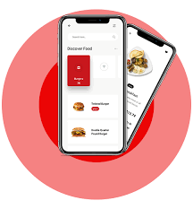
Introduction
Foodie App is an online food ordering application where customers can view the menu of their nearby available restaurants and place the order of their preferred food which will be delivered at their doorstep.
Customer can also search food item based on the restaurant and location.
The customer should Register and Login to the app to have access to the features of the app.
Authorized Customer can add their favourite food to the favourite list,which can be viewed in the favourite section.

Slide 5
Tools & Technologies Used
Gitlab-VCS
Spring Boot-Middleware
Intellij-IDE
MongoDb-Database for Restaurant Service and Favourite Service
MySql-Database for Customer Service
Postman-Front End
Junit ,Mockito-Testing
Eureka Server
Zuul Gateway
Multi Module Project
Jwt Authentication
Swagger
Logger
Validation
Exception Handling

Slide 6
Customer can register into the Foodie App.
uId:
firstName:
lastName:
username:
contactNum:
Address:
password:
A registered customer can login to the App.
username:
password:
Customer can search for the restaurants and food based on the location ,menu item and make the order.
Favorite service : customer can add his favorite food or restaurant and same will be displayed on Favorite service.
Functionalities

Slide 7
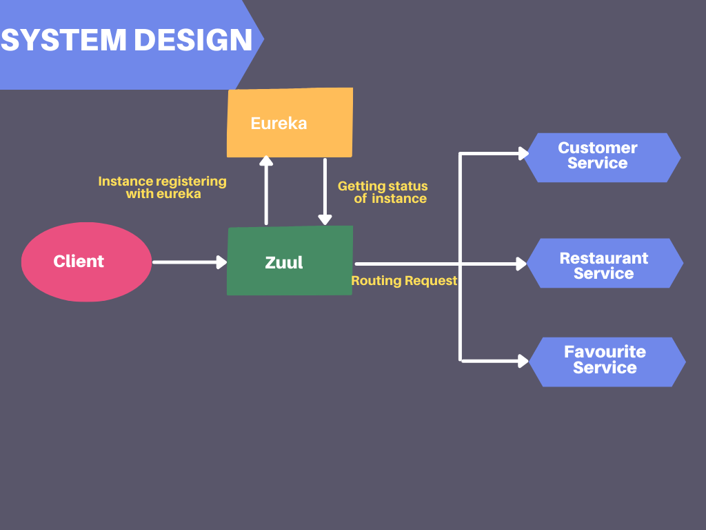
System Design

Slide 8
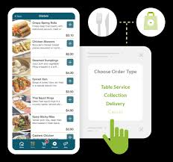
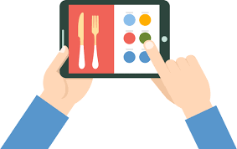
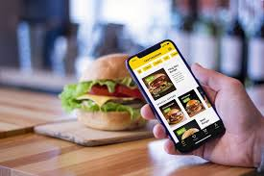
Microservices
Customer-Service
Favourite-Service
Restaurant-Service
The customer can Register and login.(update their details and delete their account.)
The Customer can add ,delete and view their favourite food in the favourite list.
The Customer can search food and place order in the restaurant-service.The customer can also search restaurant based on location,fooditem.

Slide 9
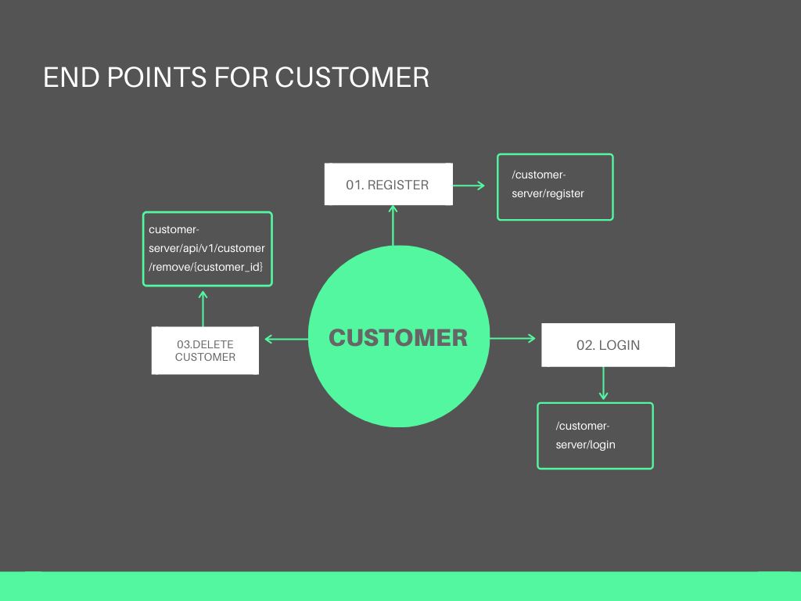
Customer-Service

Slide 10
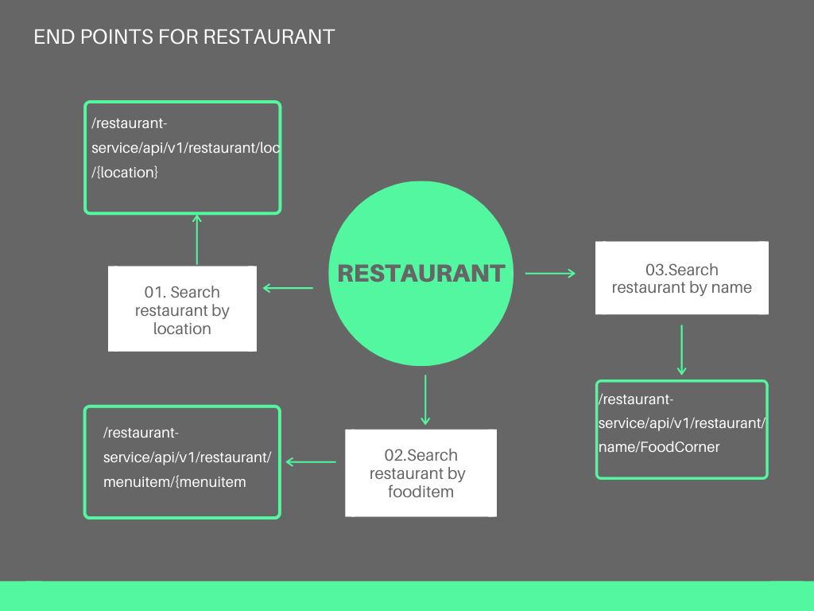
Restaurant Service

Slide 11
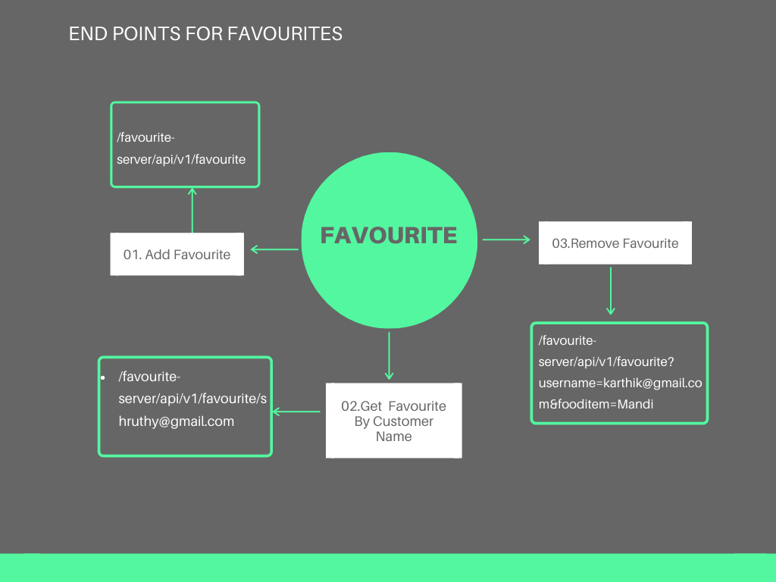
Favourites Service

Slide 12
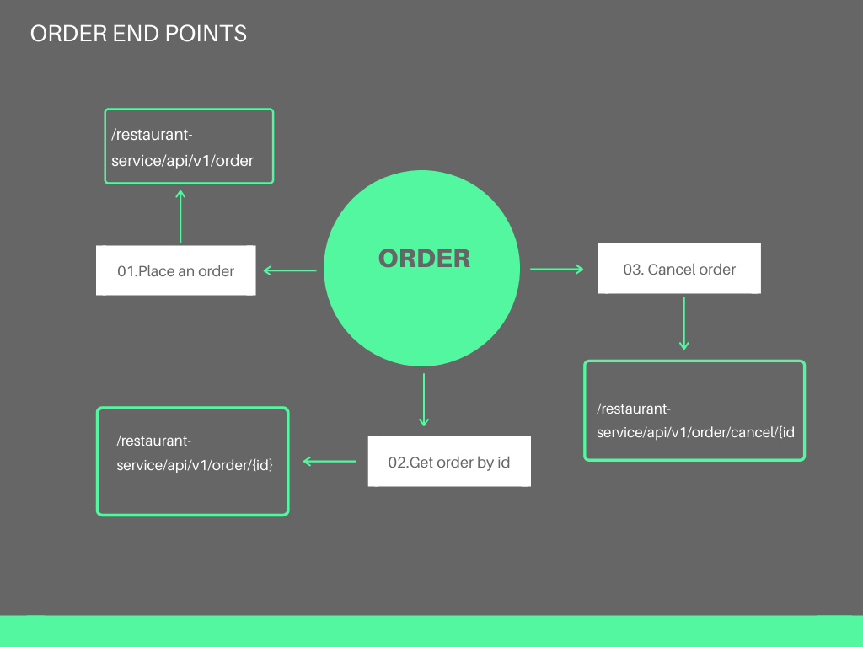
Order Service

Slide 13
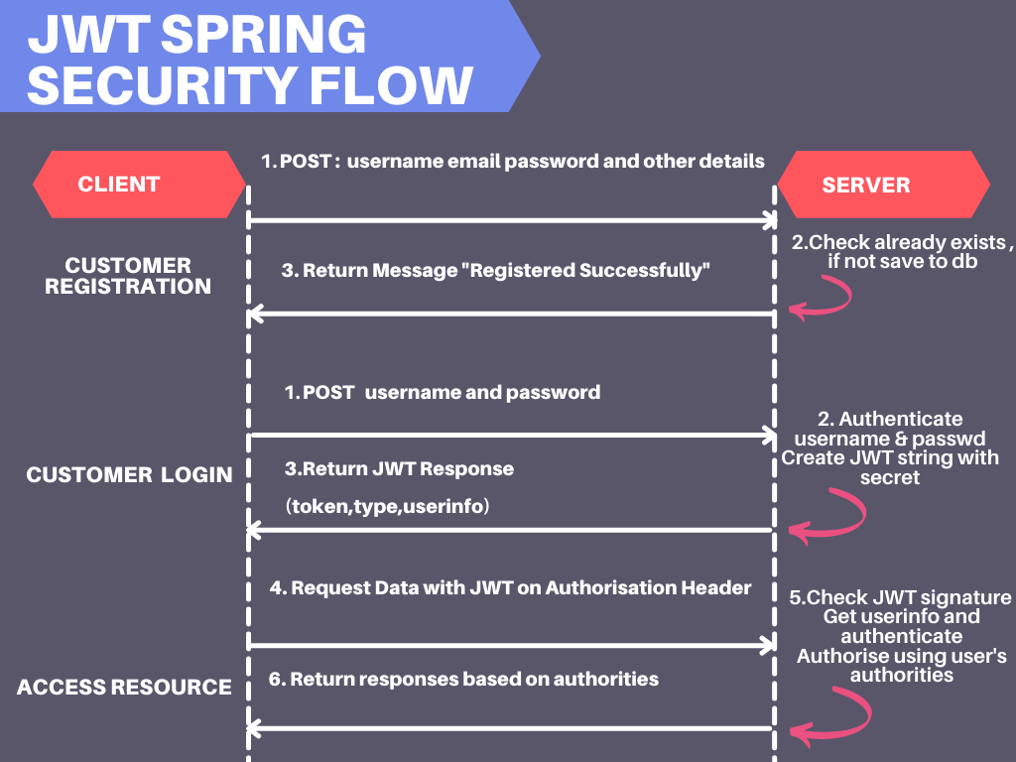

Slide 14
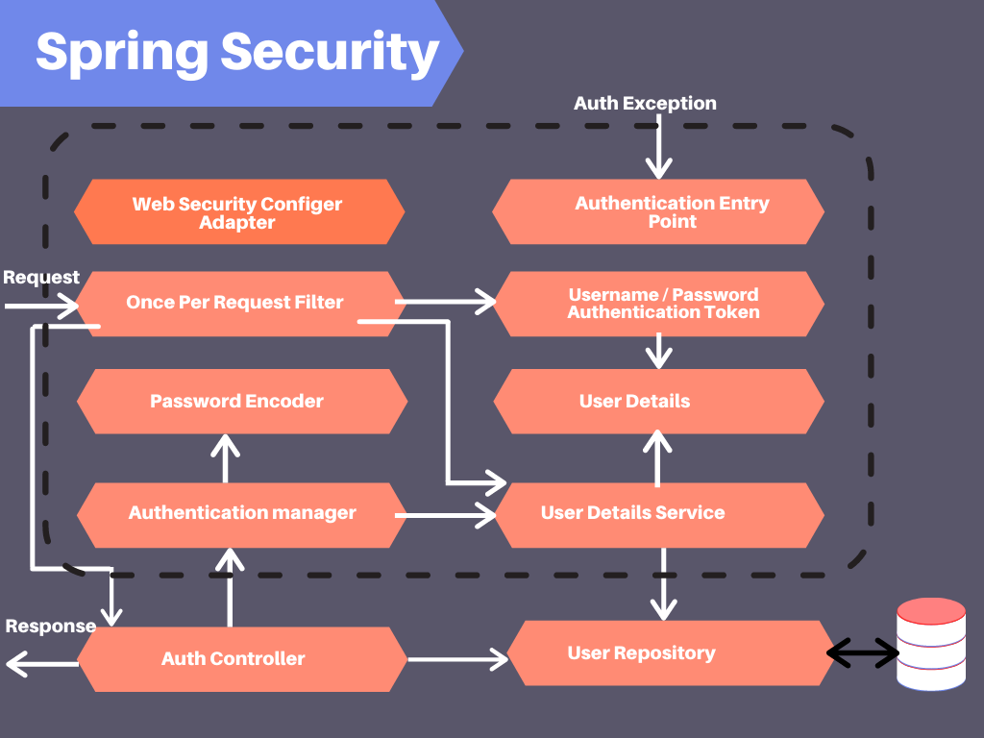

Slide 15
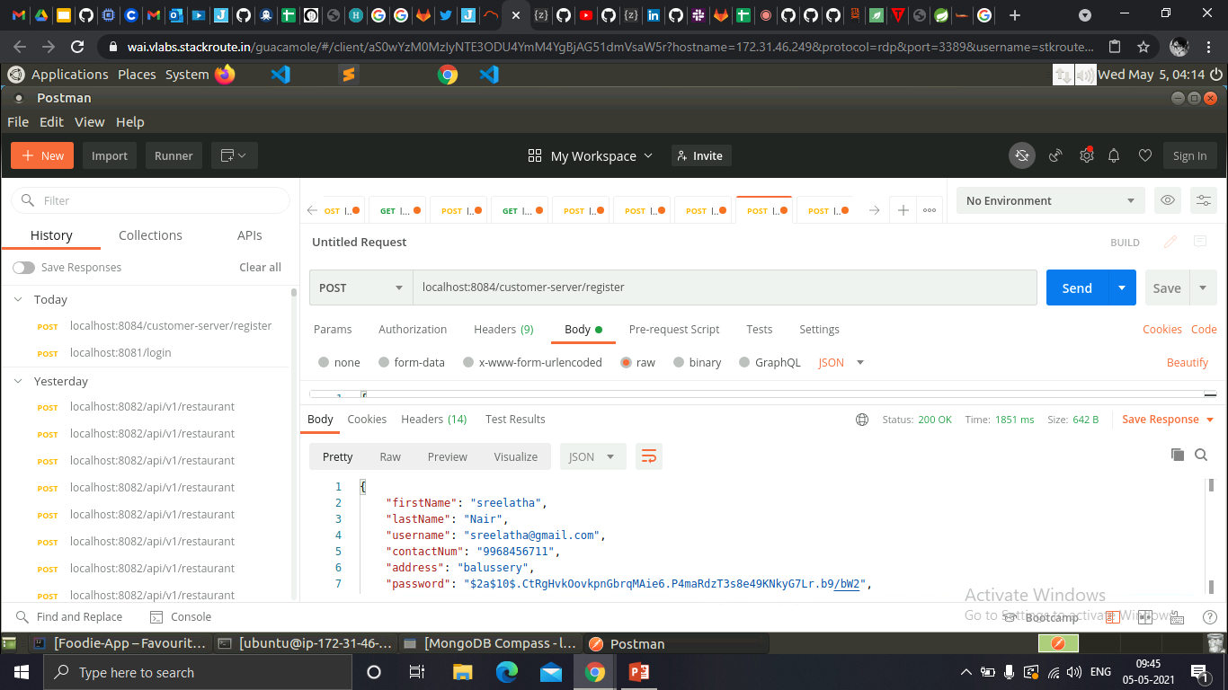
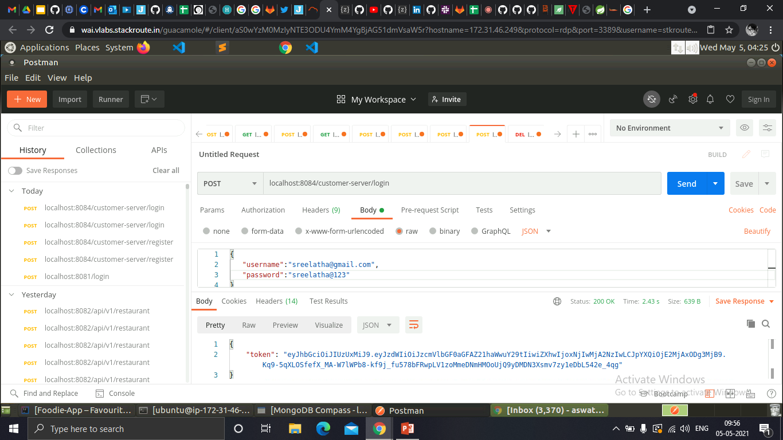
Customer-Registration and Login

Slide 16
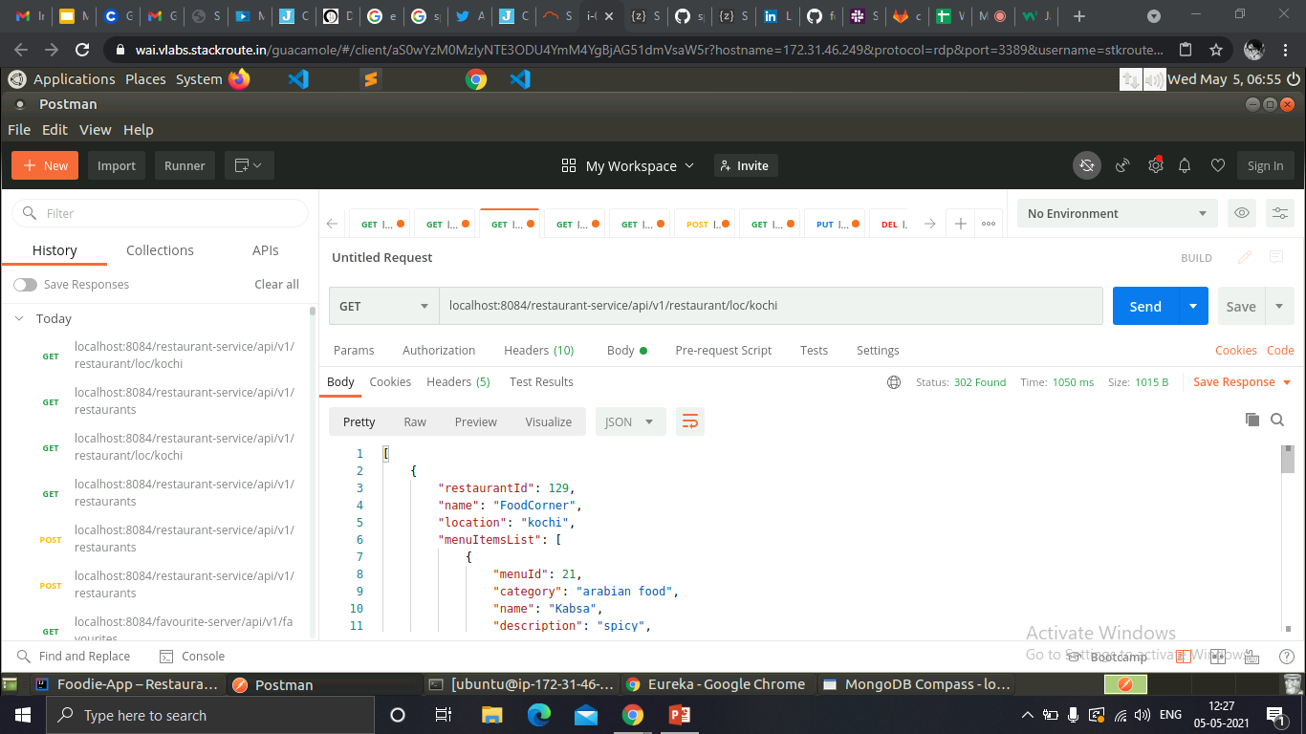
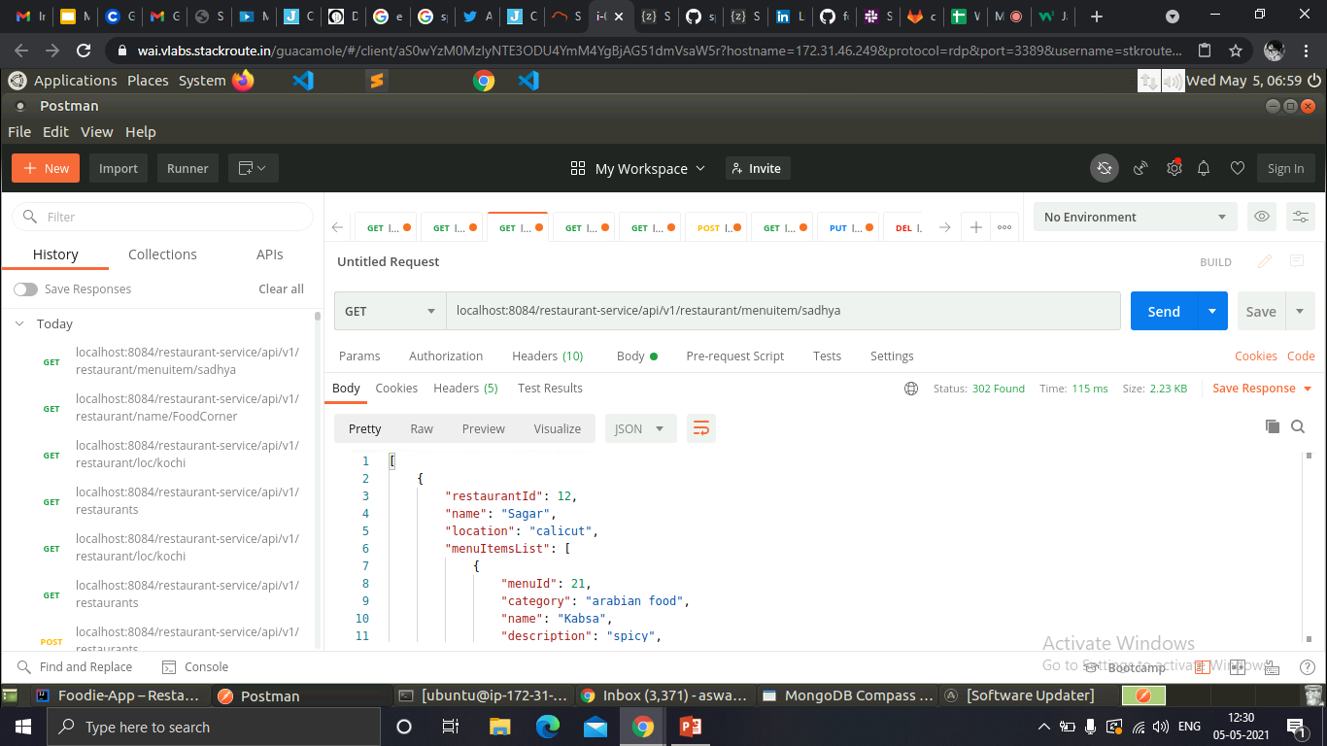
Search restaurant by location & food item

Slide 17
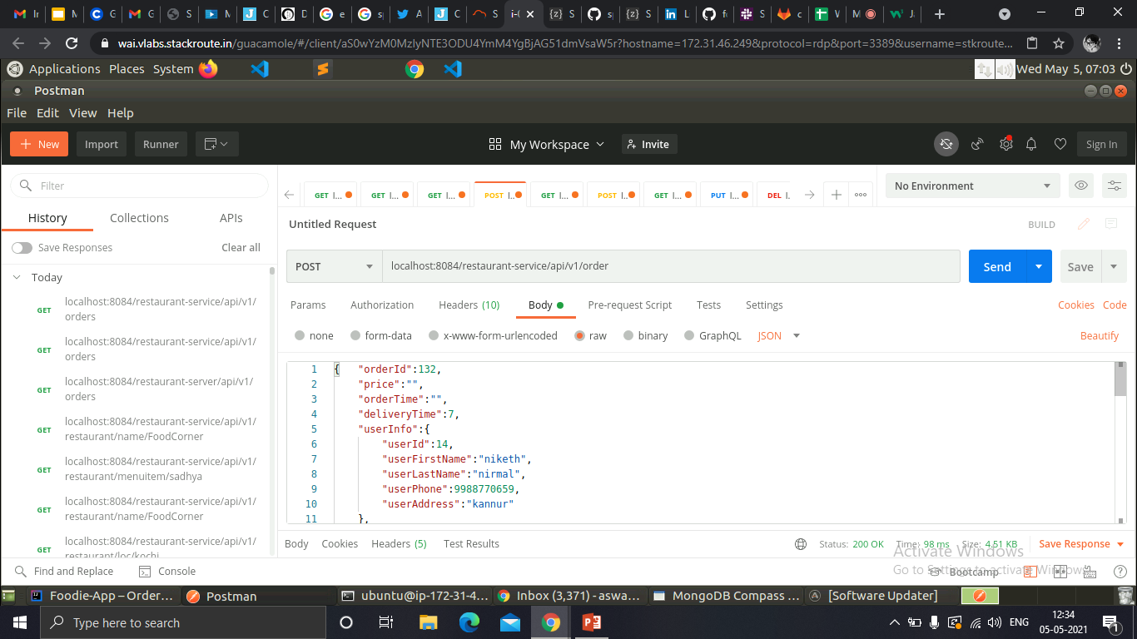
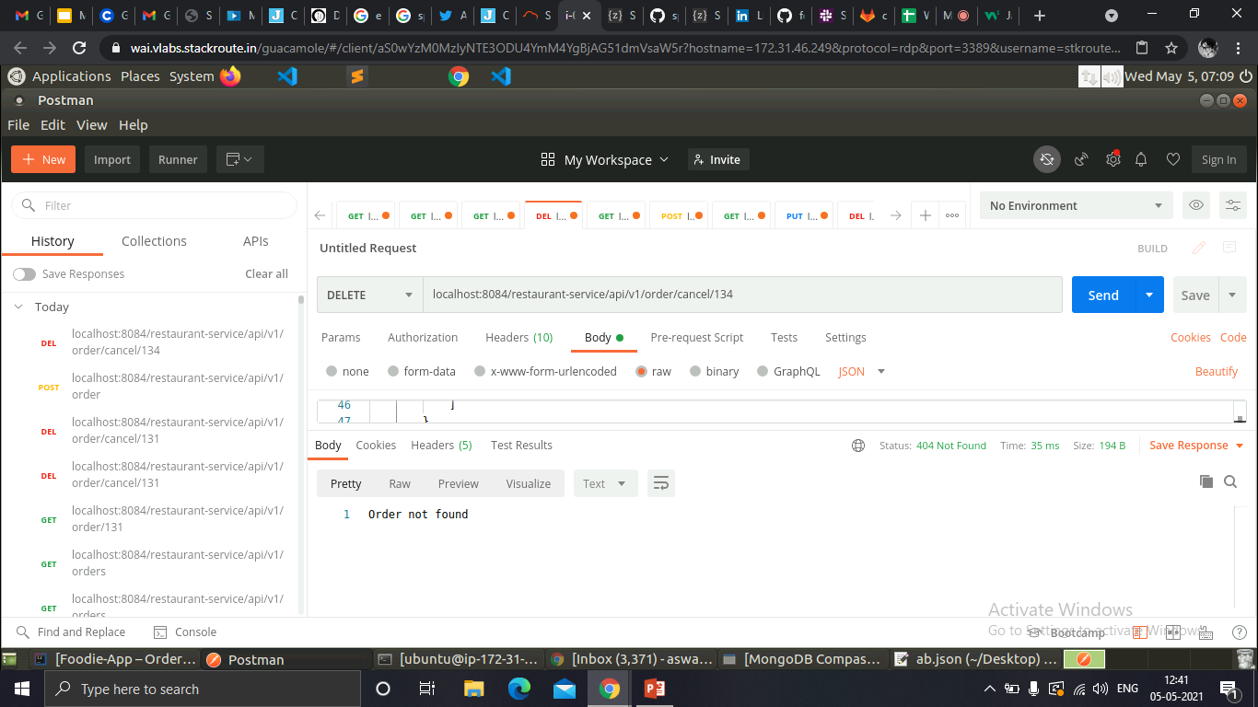
Food Order & Order cancel

Slide 18
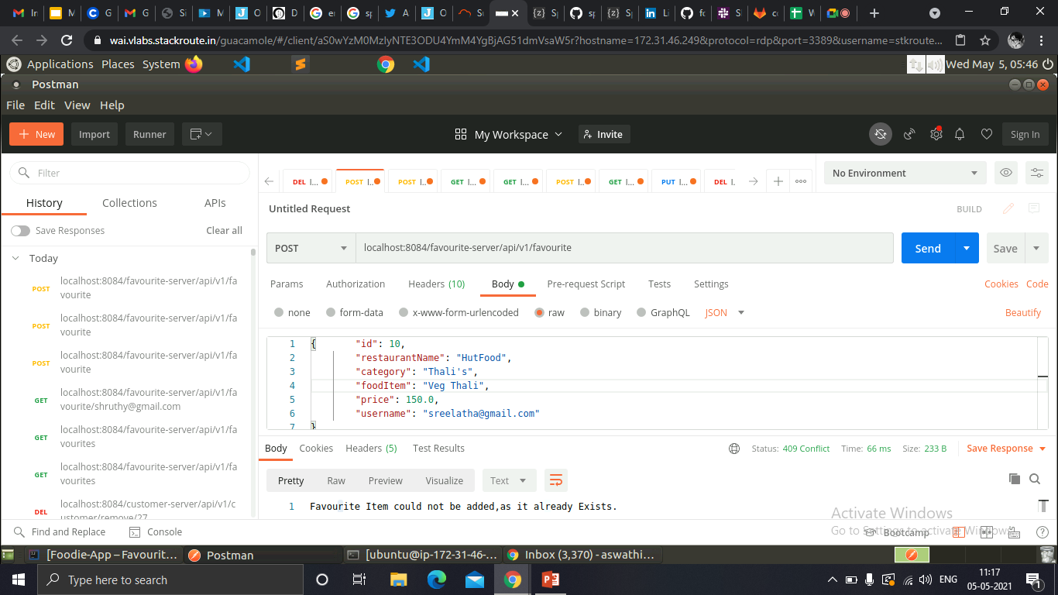
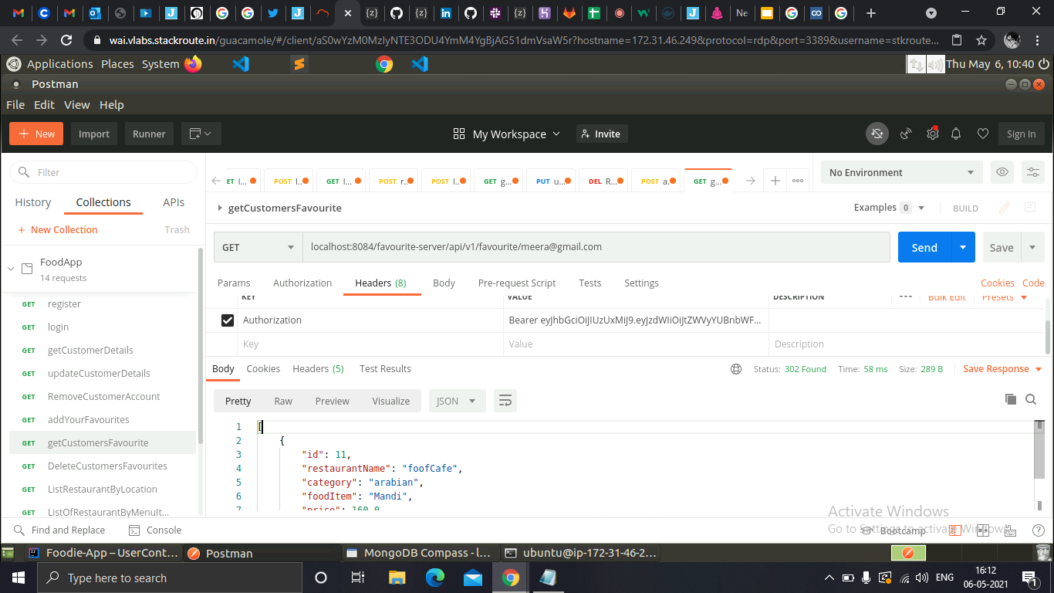
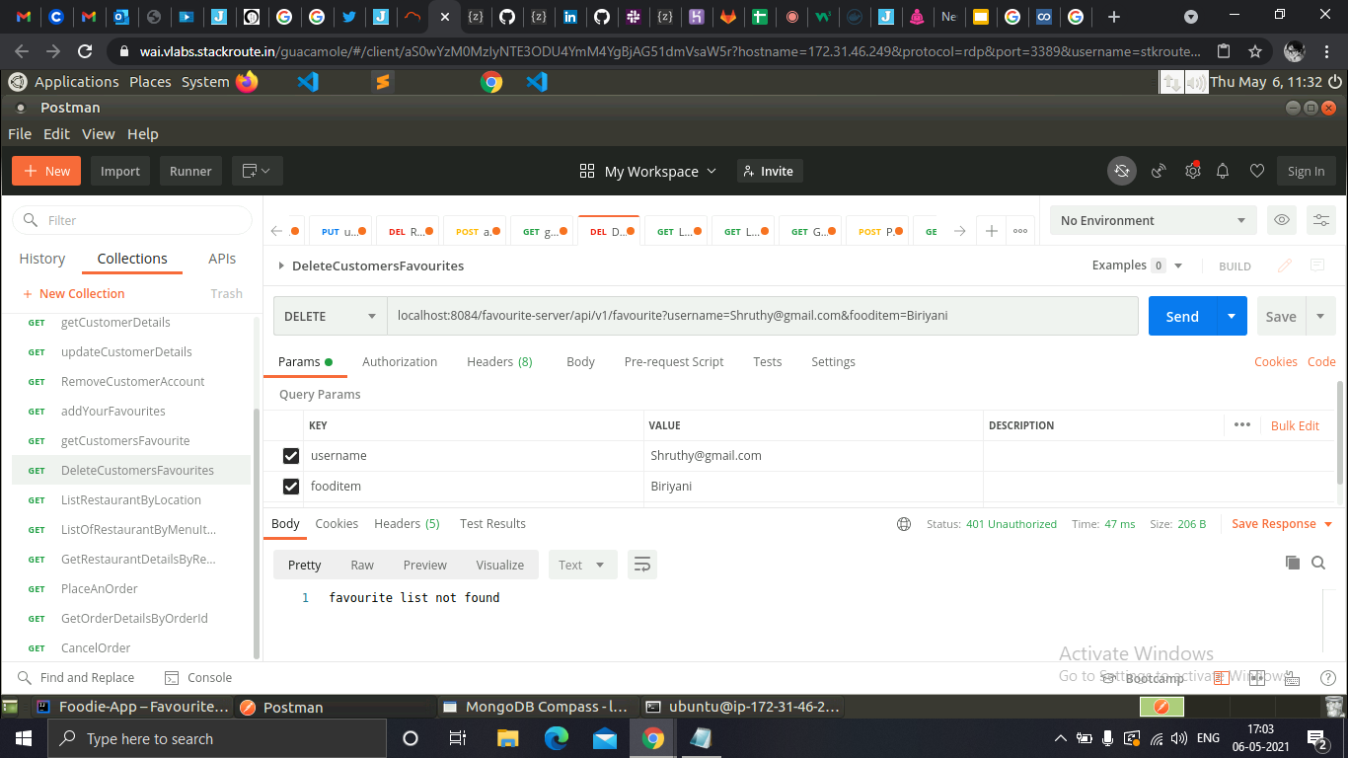
Add ,delete and search by username in Favourite

Slide 19
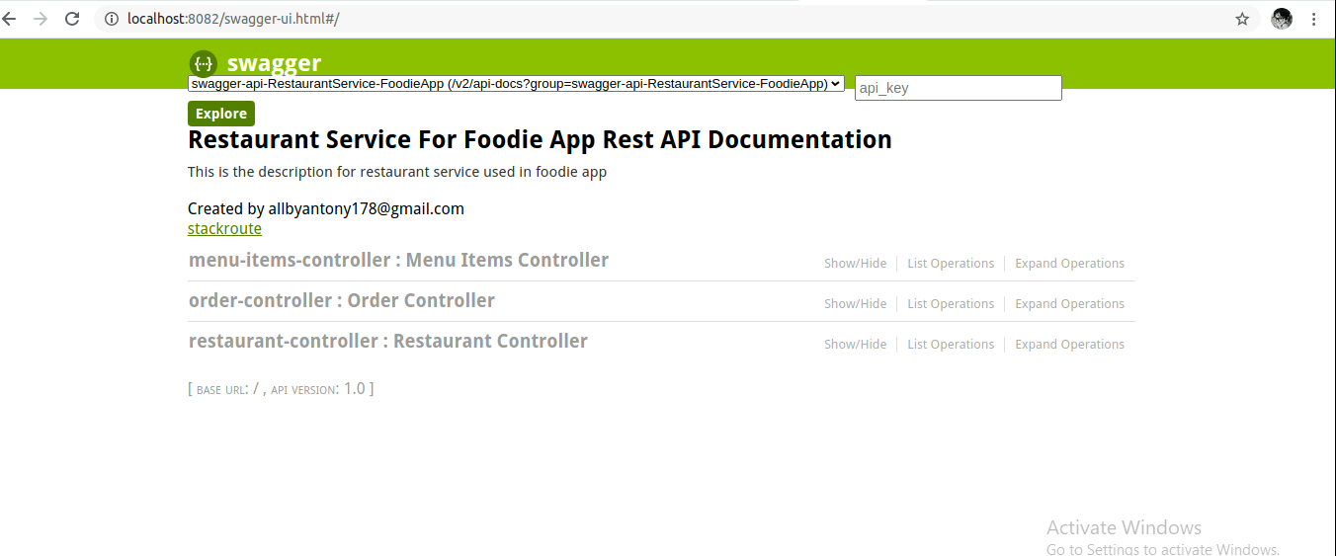
Swagger

Slide 20
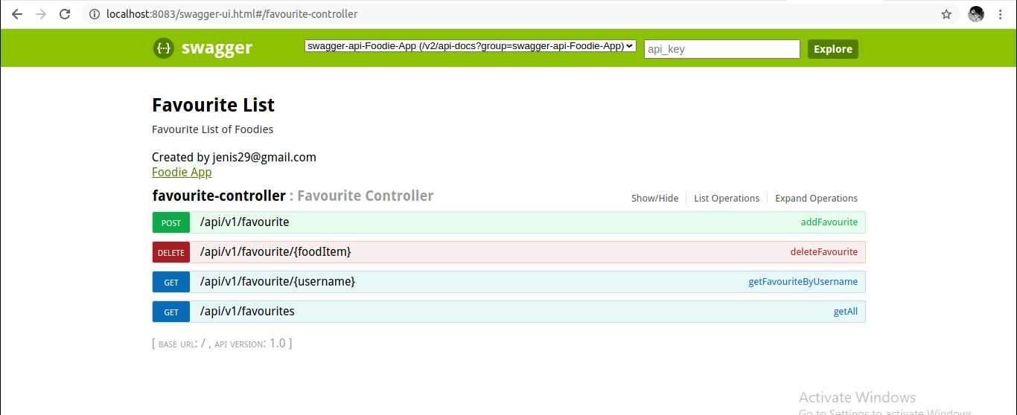
Swagger

Slide 21
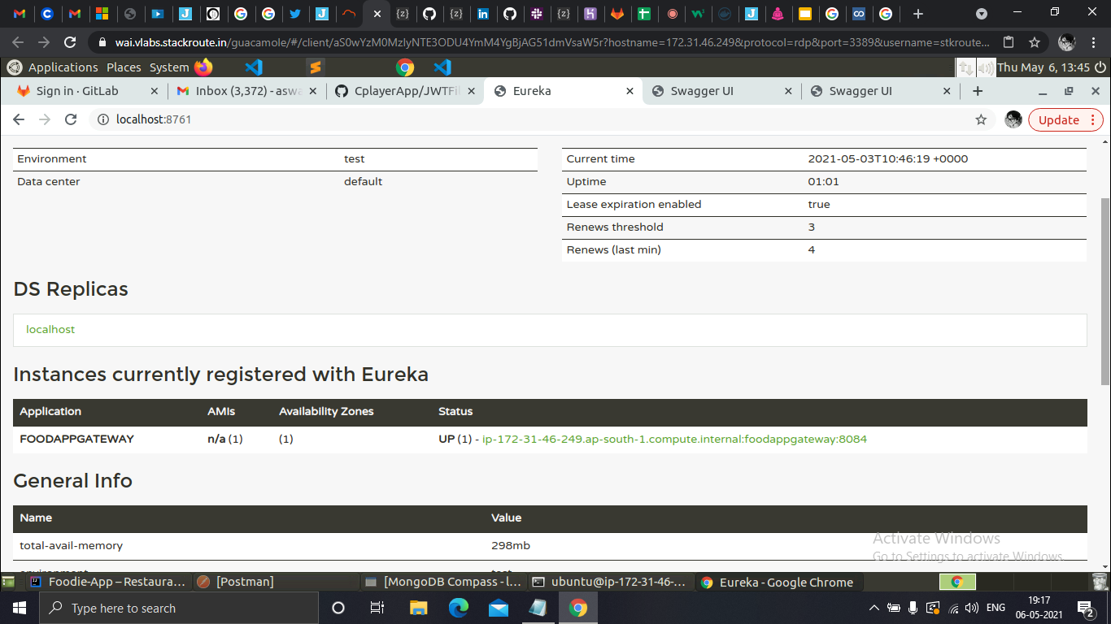
Eureka Server

Slide 22
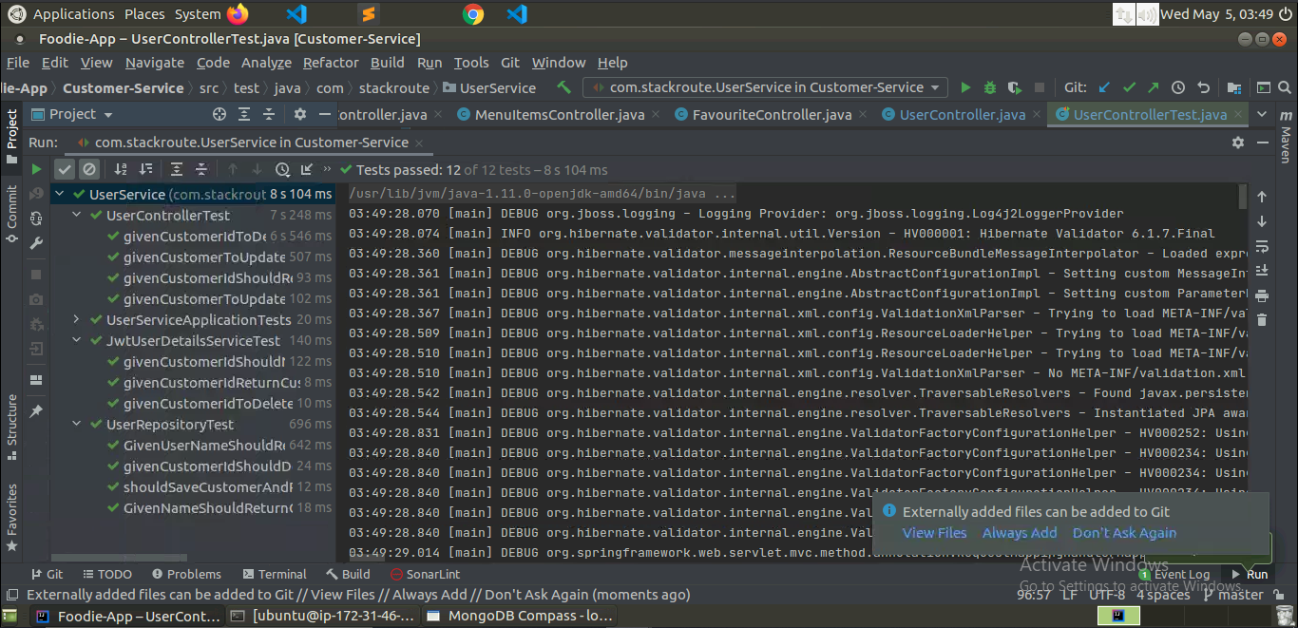
Test cases of Customer Service

Slide 23
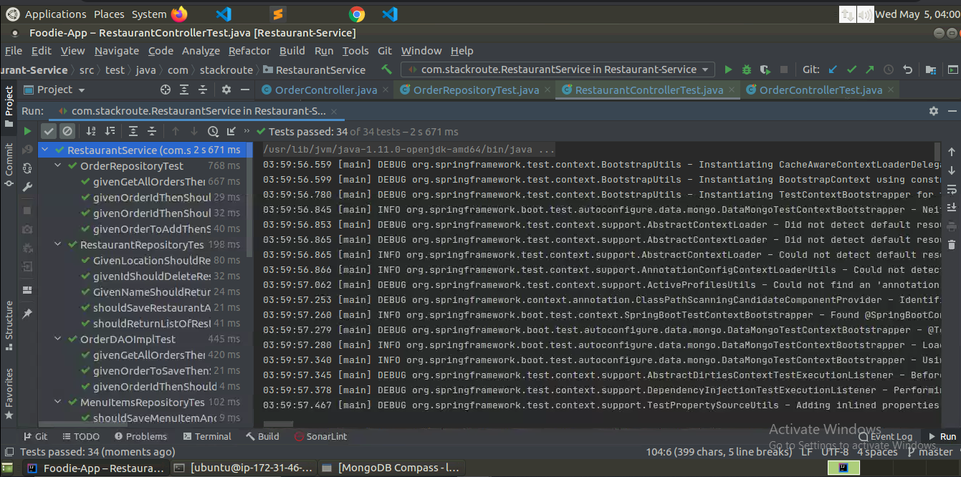
Test cases of Restaurant Service

Slide 24
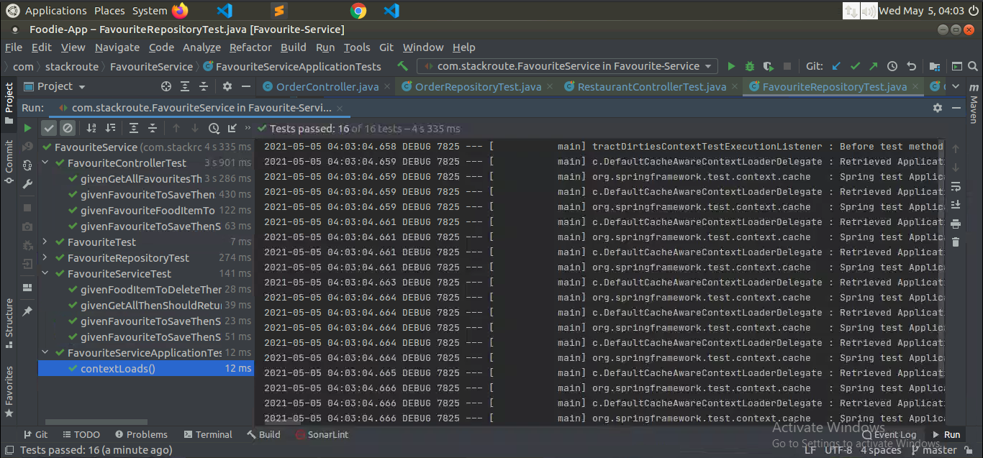
Test cases of Favourite Service

Slide 25
Thank you!

